Slide 1



ML/DL for Everyone with
Lecture 10: CNN
Sung Kim <hunkim+ml@gmail.com> HKUST
Code: https://github.com/hunkim/PyTorchZeroToAll
Slides: http://bit.ly/PyTorchZeroAll

Slide 2

Call for Comments
Please feel free to add comments directly on these slides.
Other slides: http://bit.ly/PyTorchZeroAll
Picture from http://www.tssablog.org/archives/3280

Slide 3
ML/DL for Everyone with
Lecture 10: CNN
Sung Kim <hunkim+ml@gmail.com> HKUST
Code: https://github.com/hunkim/PyTorchZeroToAll
Slides: http://bit.ly/PyTorchZeroAll

Slide 4

CNN
http://parse.ele.tue.nl/cluster/2/CNNArchitecture.jpg

Slide 5
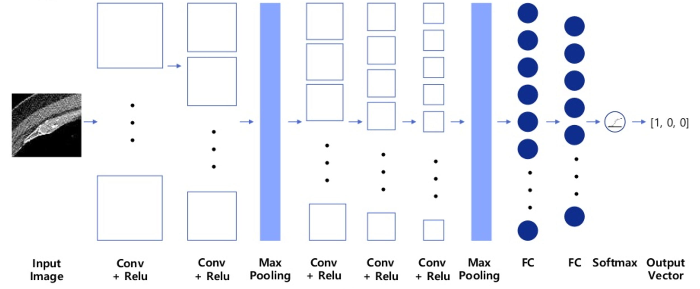
CNN for CT images
Asan Medical Center & Microsoft Medical Bigdata Contest Winner by GeunYoung Lee and Alex Kim
https://www.slideshare.net/GYLee3/ss-72966495

Slide 6
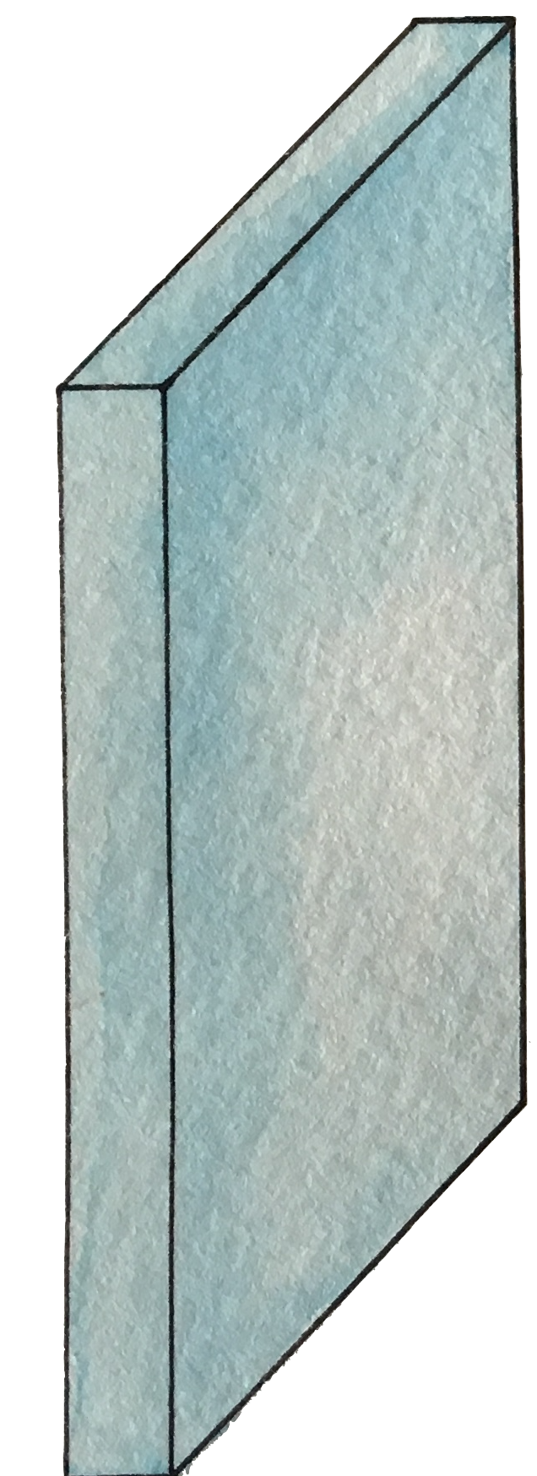
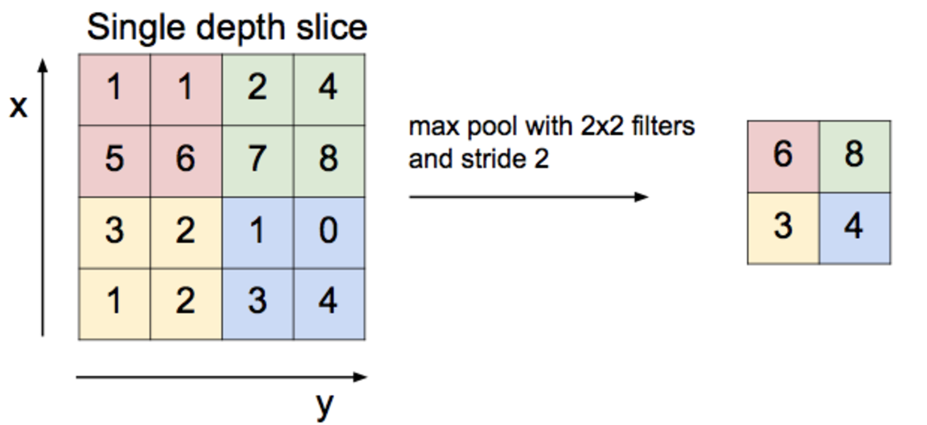
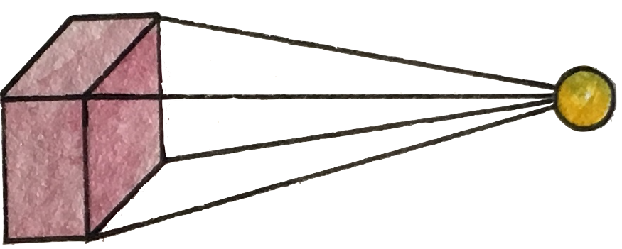
Convolution layer and max pooling

Slide 7
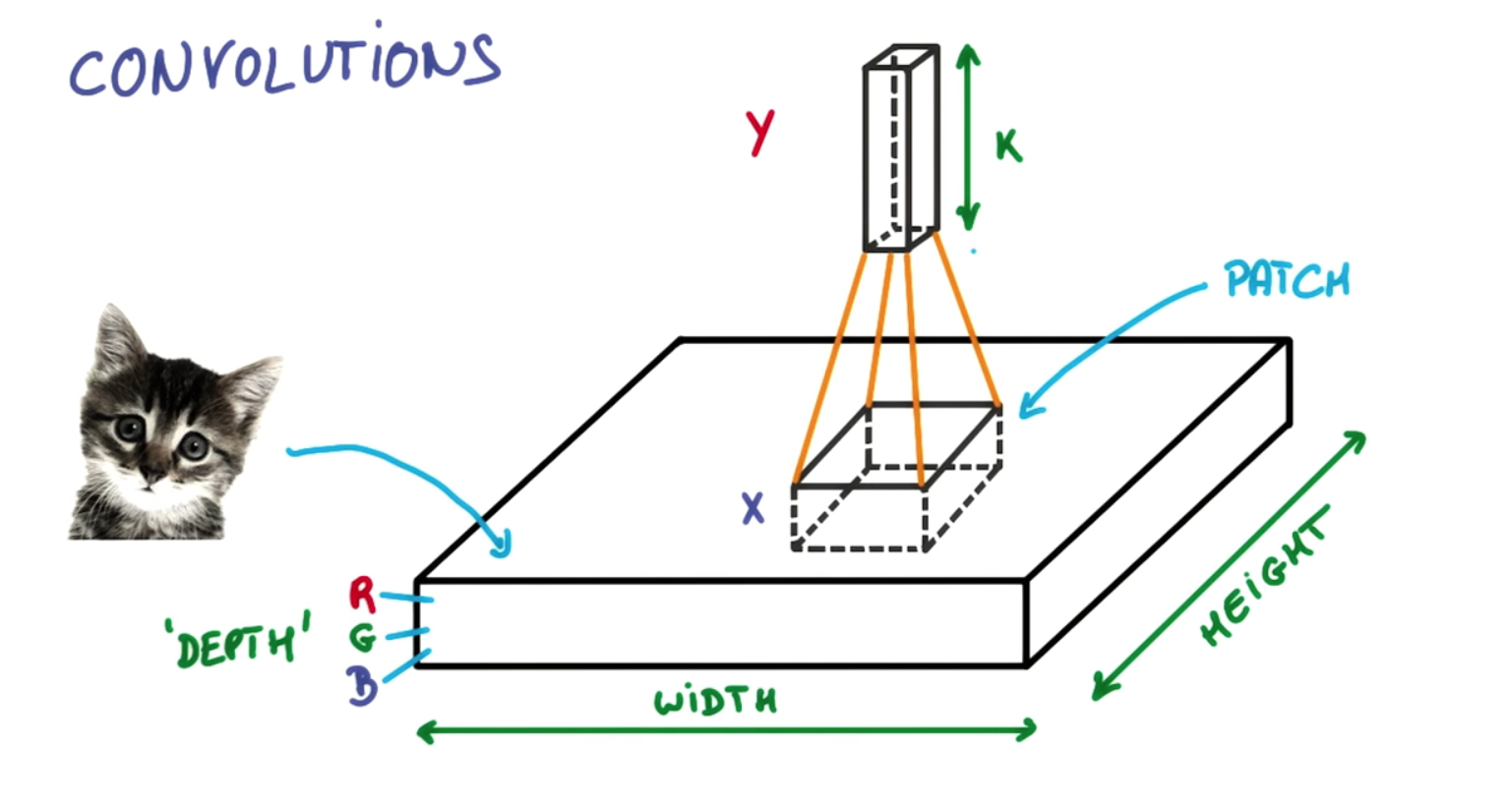
https://ireneli.eu/2016/02/03/deep-learning-05-talk-about-convolutional-neural-network%EF%BC%88cnn%EF%BC%89/

Slide 8
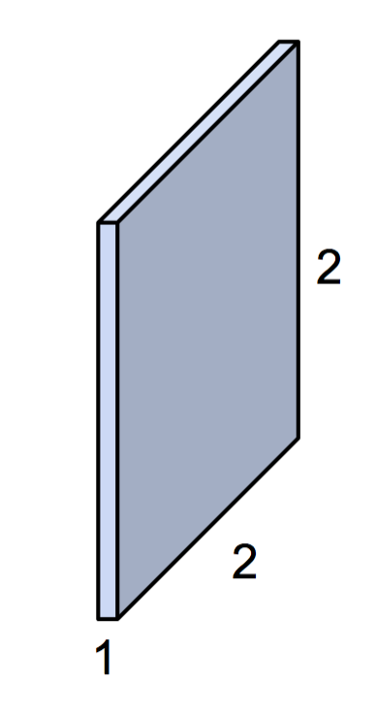
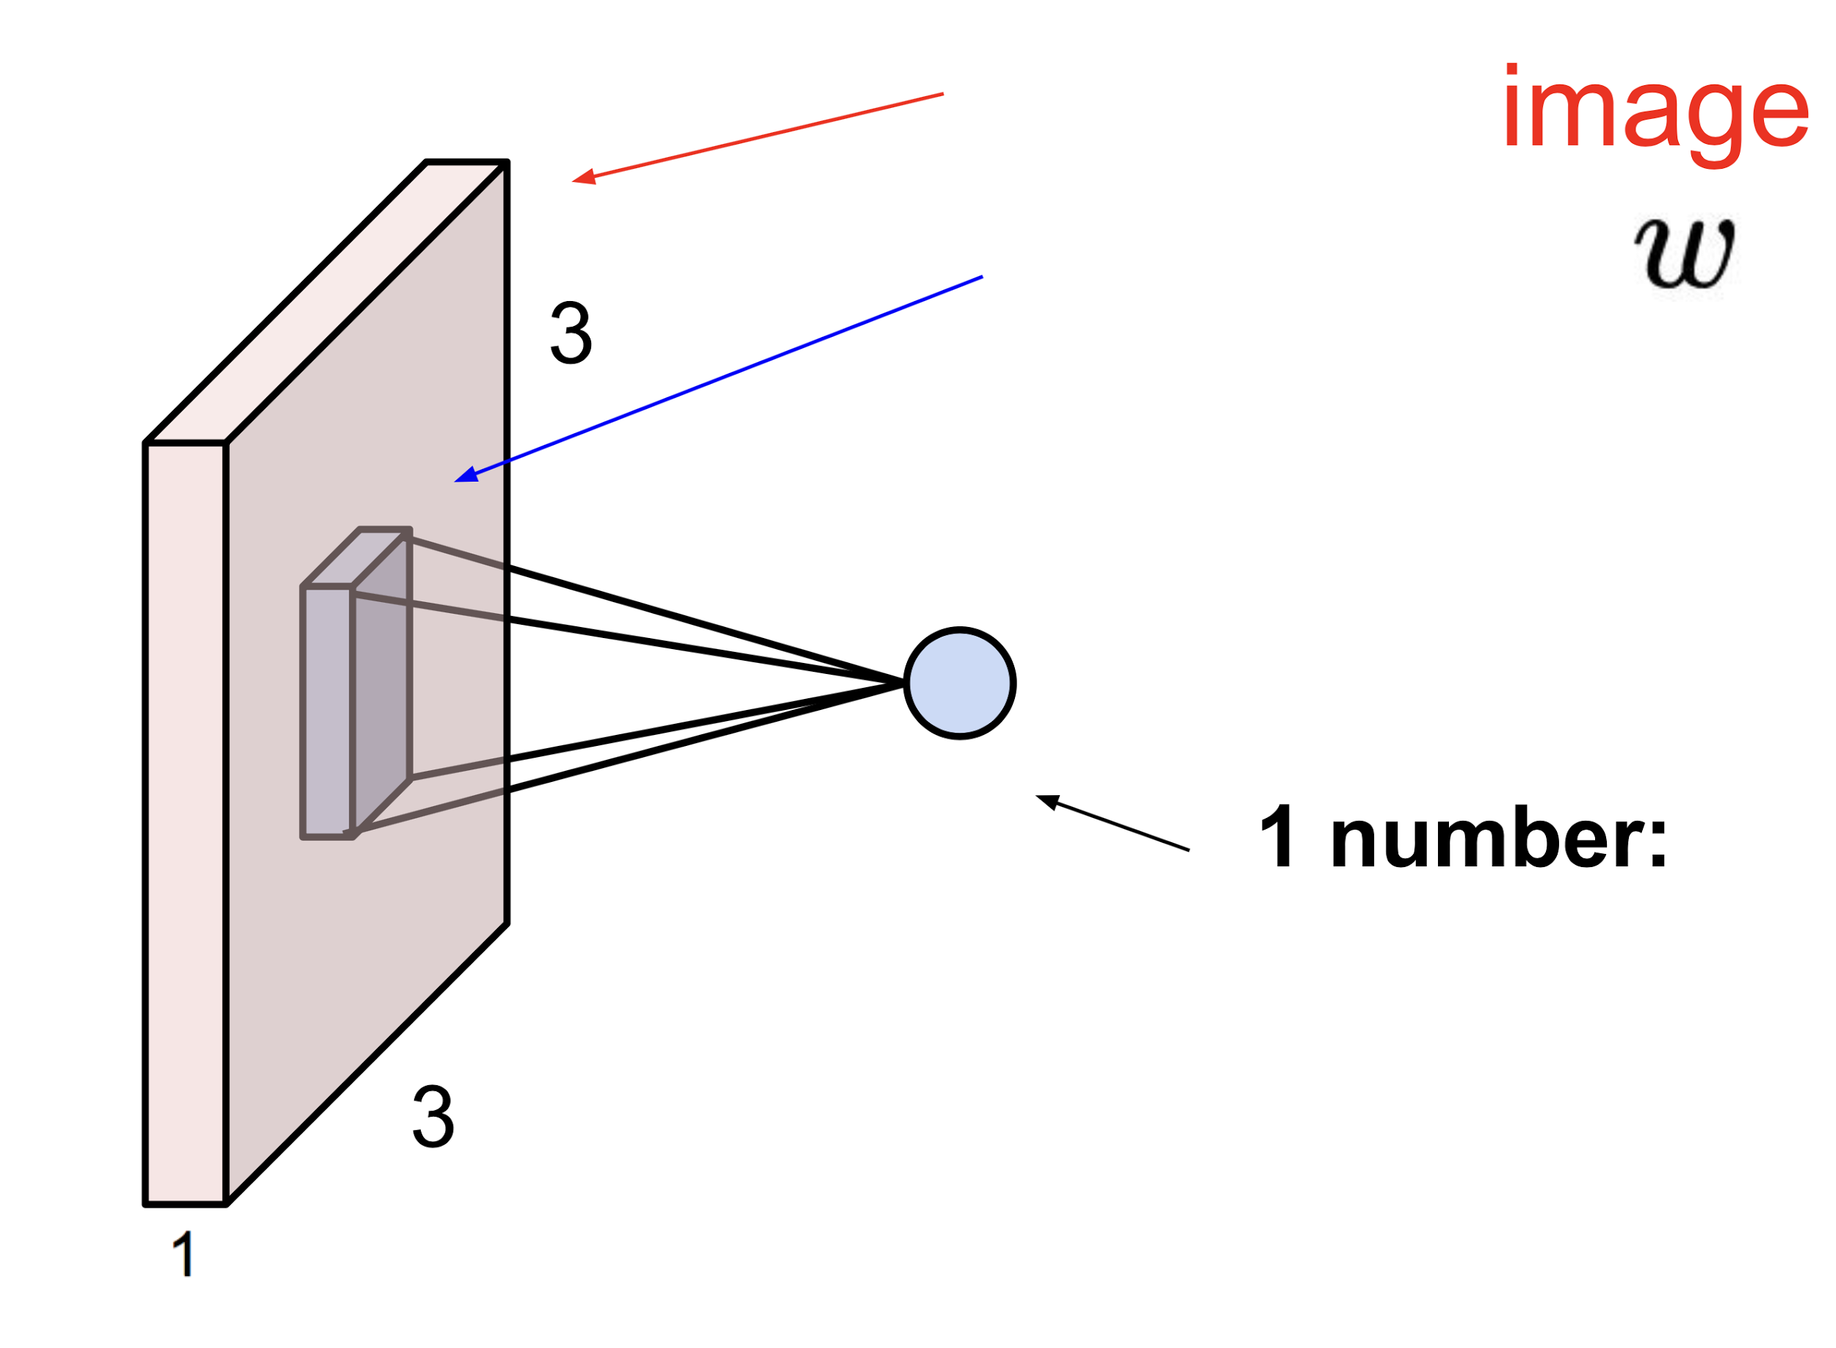
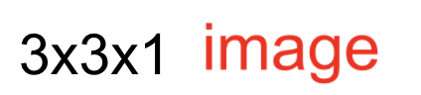
Simple convolution layer
Stride: 1x1
3x3x1
2x2x1 filter

Slide 9
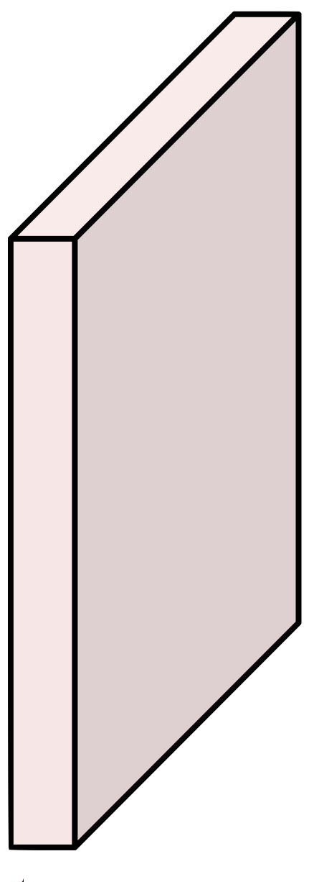
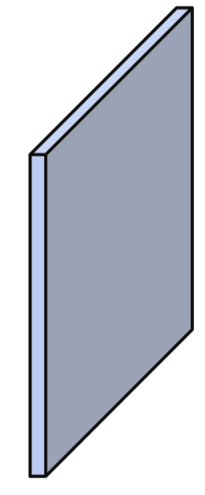
Simple convolution layer
Image: 1,3,3,1 image, Filter: 2,2,1,1, Stride: 1x1, Padding: VALID
3
2
1
6
1
5
1
4
1
9
8
1
7

Slide 10
Simple convolution layer
Image: 1,3,3,1 image, Filter: 2,2,1,1, Stride: 1x1, Padding: SAME
0
3
2
1
0
6
1
5
1
3
4
0
1
9
8
0
1
7
0
3
0
0

Slide 11
Max pooling

Slide 12
CNN
http://parse.ele.tue.nl/cluster/2/CNNArchitecture.jpg

Slide 13
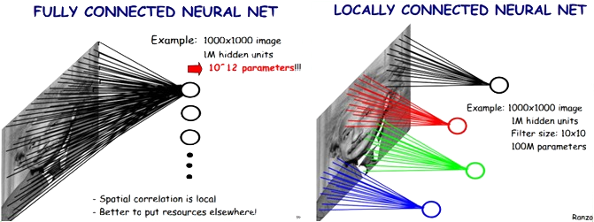
Locally Connected Features
https://ireneli.eu/2016/02/03/deep-learning-05-talk-about-convolutional-neural-network%EF%BC%88cnn%EF%BC%89/

Slide 14
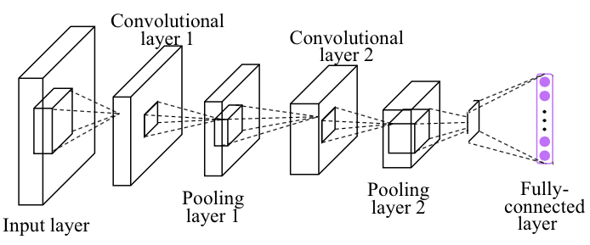
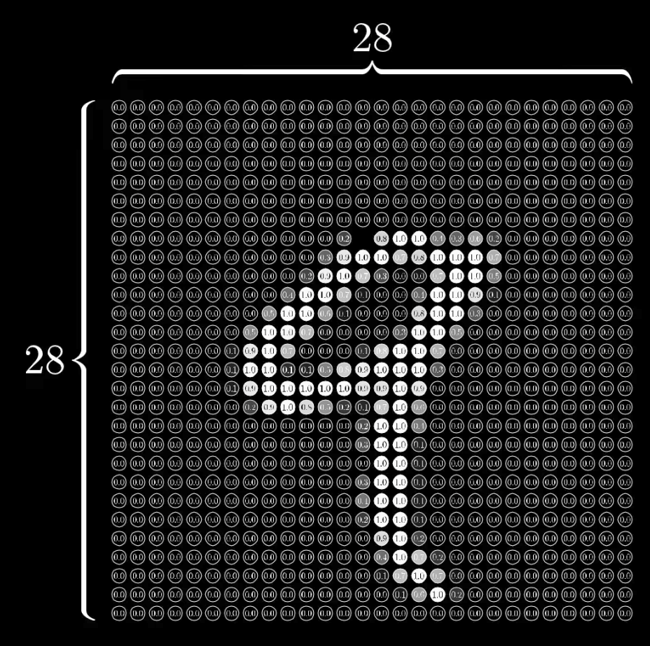
Simple CNN
self.fc = nn.Linear(320, 10)
Linear
nn.MaxPool2d
( kernel_size)
torch.nn.Conv2d (in_channels,
out_channels,
kernel_size)
self.mp = nn.MaxPool2d(2)
self.conv1 = nn.Conv2d(1, 10, kernel_size=5)

Slide 15

Simple CNN
class Net(nn.Module):
def __init__(self):
super(Net, self).__init__()
self.conv1 = nn.Conv2d(1, 10, kernel_size=5)
self.conv2 = nn.Conv2d(10, 20, kernel_size=5)
self.mp = nn.MaxPool2d(2)
self.fc = nn.Linear(?, 10) # 320 -> 10
def forward(self, x):
in_size = x.size(0)
x = F.relu(self.mp(self.conv1(x)))
x = F.relu(self.mp(self.conv2(x)))
x = x.view(in_size, -1) # flatten the tensor
x = self.fc(x)
return F.log_softmax(x)
RuntimeError: size mismatch, m1: [64 x 320], m2: [100 x 10]
Notes:
\hat{y}=x*w+b
loss = \frac{1}{N}\sum_{n=1}^{N} y^{(n)} \log \hat{y}^{(n)} + (1 - y^{(n)}) \log (1-\hat{y}^{(n})

Slide 16
Simple CNN
class Net(nn.Module):
def __init__(self):
super(Net, self).__init__()
self.conv1 = nn.Conv2d(1, 10, kernel_size=5)
self.conv2 = nn.Conv2d(10, 20, kernel_size=5)
self.mp = nn.MaxPool2d(2)
self.fc = nn.Linear(?, 10) # 320 -> 10
def forward(self, x):
in_size = x.size(0)
x = F.relu(self.mp(self.conv1(x)))
x = F.relu(self.mp(self.conv2(x)))
x = x.view(in_size, -1) # flatten the tensor
x = self.fc(x)
return F.log_softmax(x)
Train Epoch: 9 [46080/60000 (77%)] Loss: 0.108415
Train Epoch: 9 [46720/60000 (78%)] Loss: 0.140700
Train Epoch: 9 [47360/60000 (79%)] Loss: 0.090830
Train Epoch: 9 [48000/60000 (80%)] Loss: 0.031640
Train Epoch: 9 [48640/60000 (81%)] Loss: 0.014934
Train Epoch: 9 [49280/60000 (82%)] Loss: 0.090210
Train Epoch: 9 [49920/60000 (83%)] Loss: 0.074975
Train Epoch: 9 [50560/60000 (84%)] Loss: 0.058671
Train Epoch: 9 [51200/60000 (85%)] Loss: 0.023464
Train Epoch: 9 [51840/60000 (86%)] Loss: 0.018025
Train Epoch: 9 [52480/60000 (87%)] Loss: 0.098865
Train Epoch: 9 [53120/60000 (88%)] Loss: 0.013985
Train Epoch: 9 [53760/60000 (90%)] Loss: 0.070476
Train Epoch: 9 [54400/60000 (91%)] Loss: 0.065411
Train Epoch: 9 [55040/60000 (92%)] Loss: 0.028783
Train Epoch: 9 [55680/60000 (93%)] Loss: 0.008333
Train Epoch: 9 [56320/60000 (94%)] Loss: 0.020412
Train Epoch: 9 [56960/60000 (95%)] Loss: 0.036749
Train Epoch: 9 [57600/60000 (96%)] Loss: 0.163087
Train Epoch: 9 [58240/60000 (97%)] Loss: 0.117539
Train Epoch: 9 [58880/60000 (98%)] Loss: 0.032256
Train Epoch: 9 [59520/60000 (99%)] Loss: 0.026360
Test set: Average loss: 0.0483, Accuracy: 9846/10000 (98%)
Notes:
\hat{y}=x*w+b
loss = \frac{1}{N}\sum_{n=1}^{N} y^{(n)} \log \hat{y}^{(n)} + (1 - y^{(n)}) \log (1-\hat{y}^{(n})

Slide 17
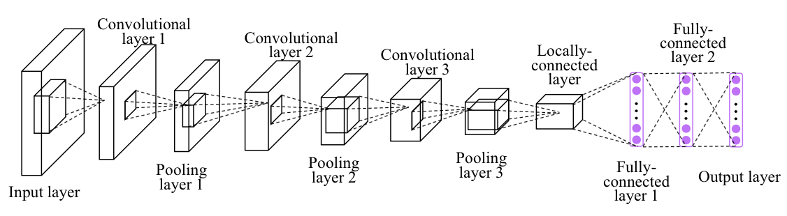
Exercise1: CNN more layers

Slide 18
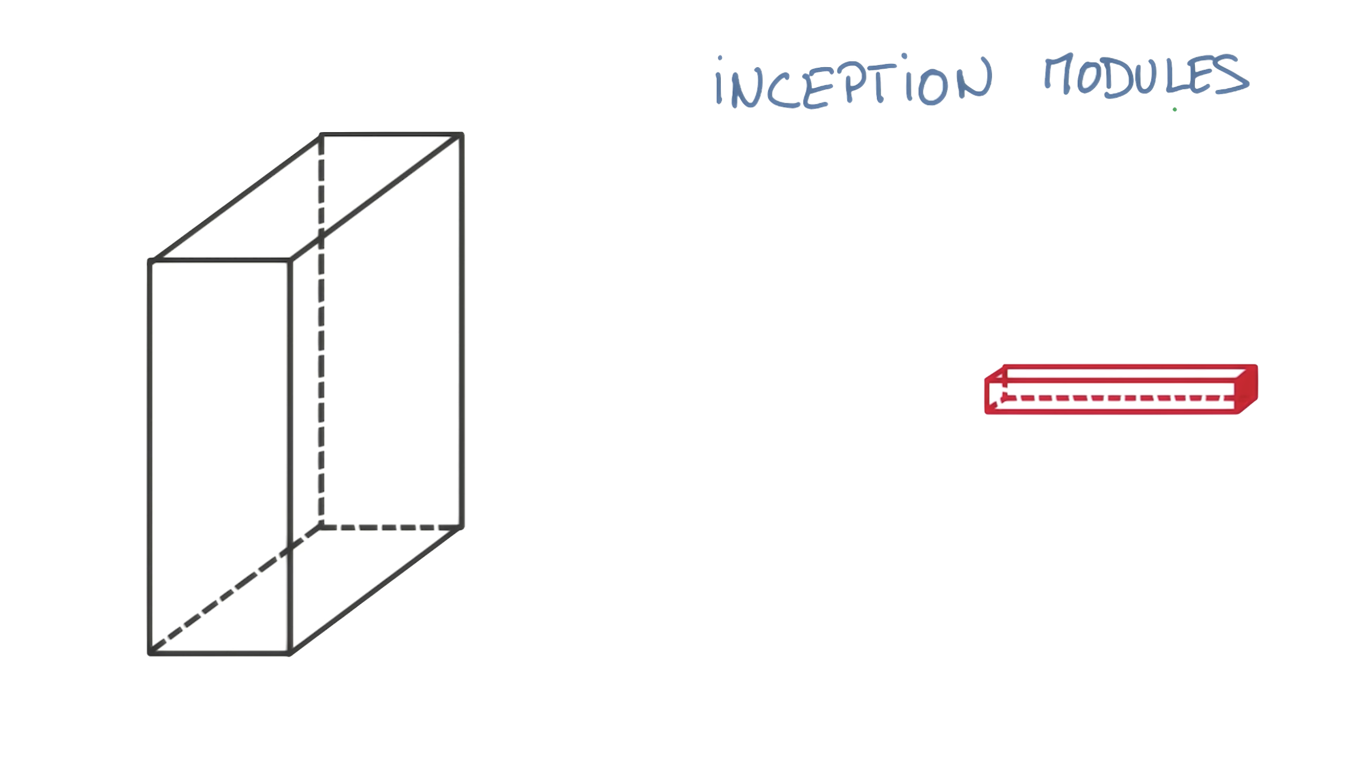
https://www.youtube.com/watch?v=VxhSouuSZDY

Slide 19
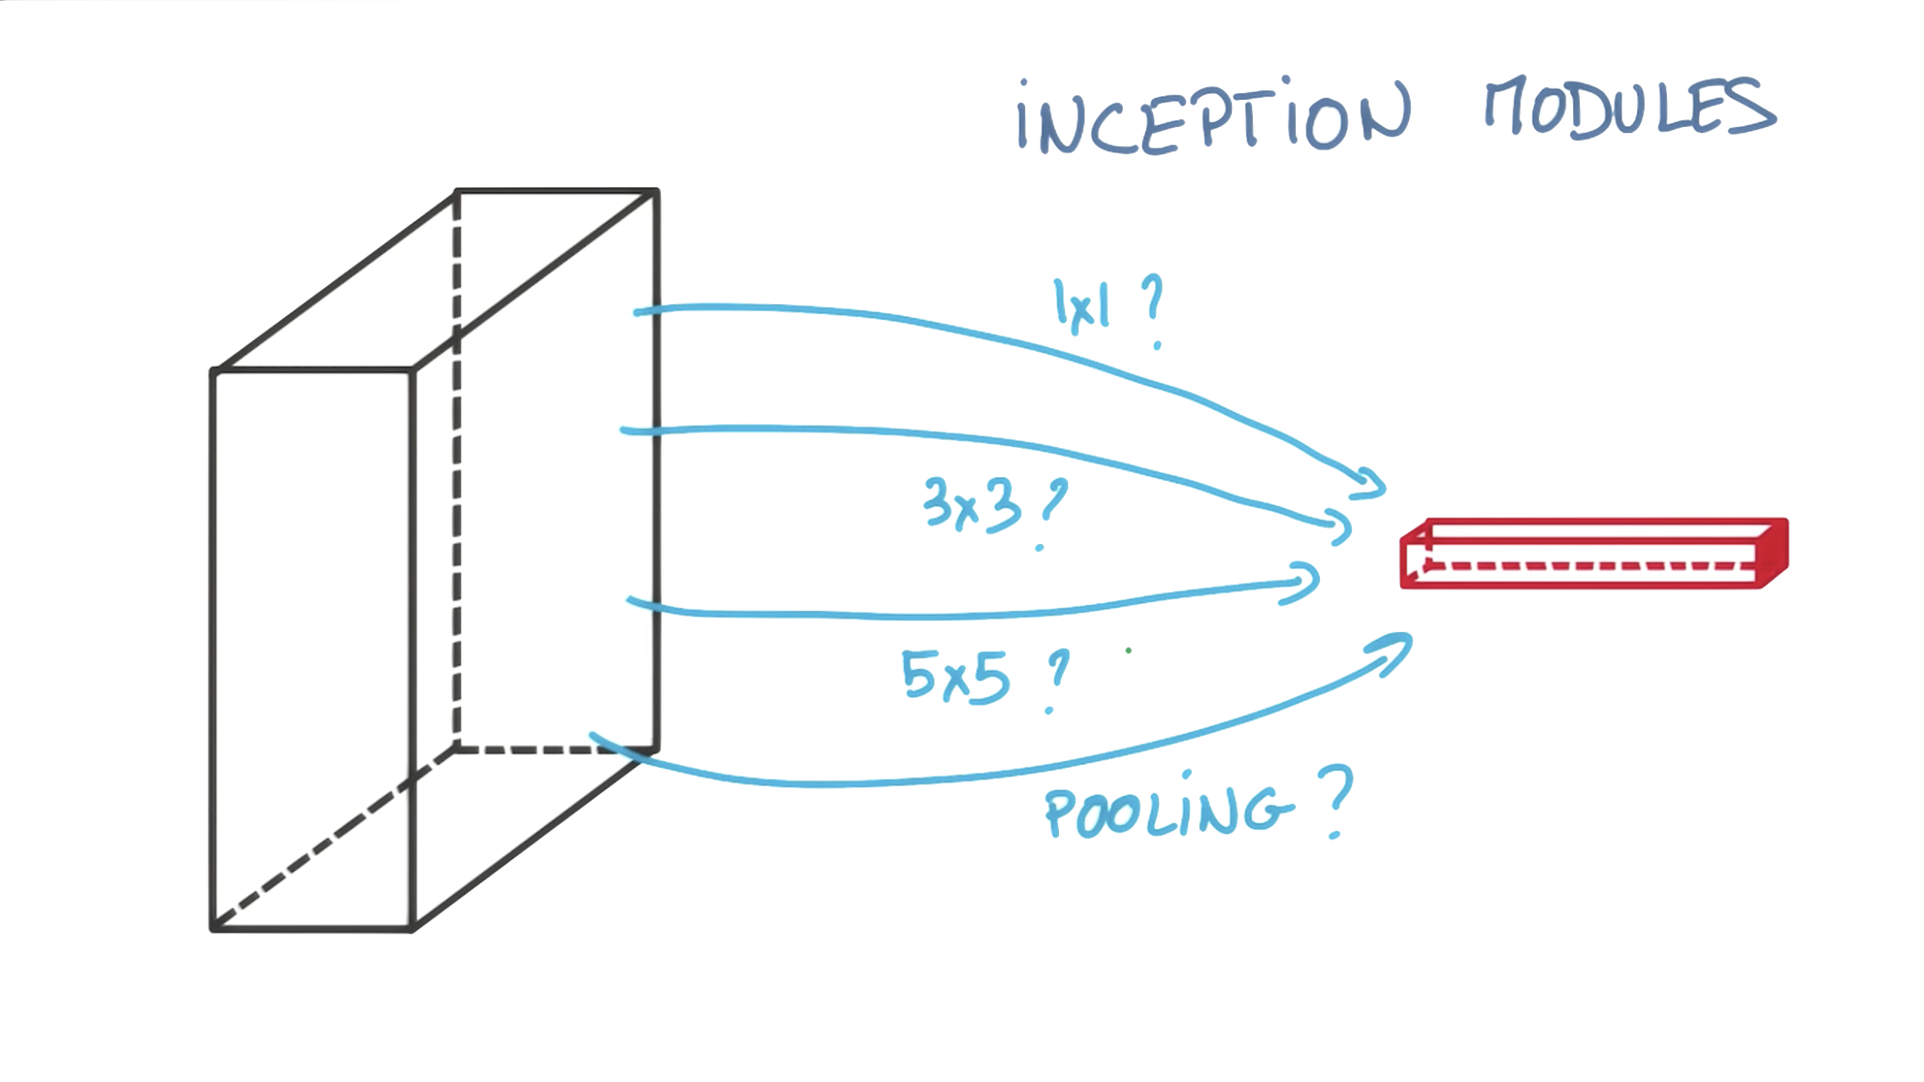
https://www.youtube.com/watch?v=VxhSouuSZDY

Slide 20
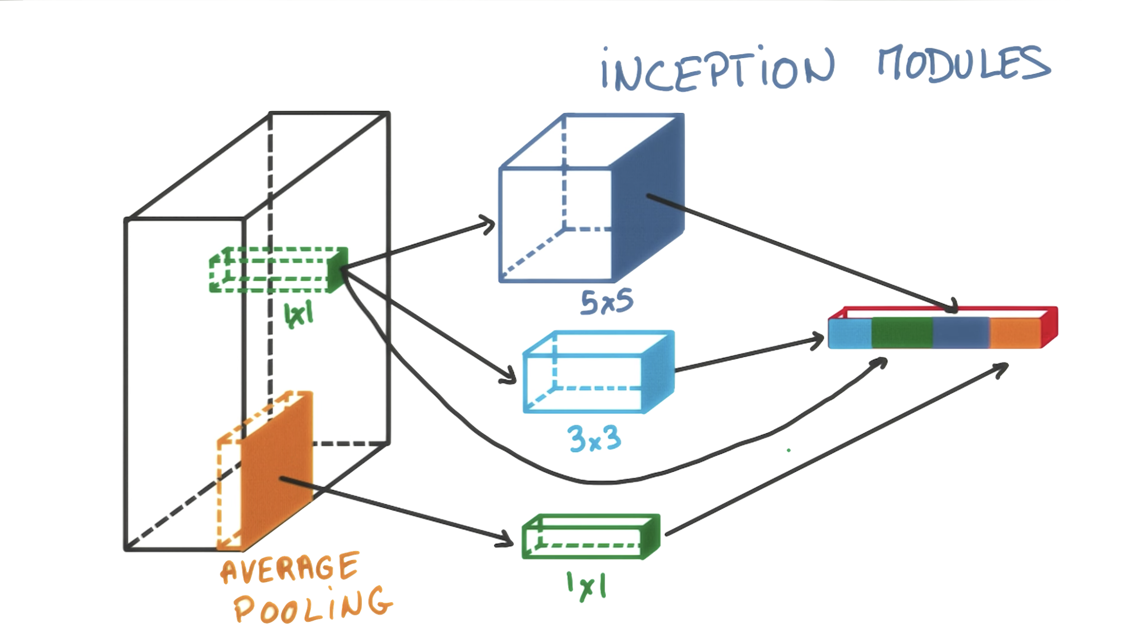
https://www.youtube.com/watch?v=VxhSouuSZDY

Slide 21
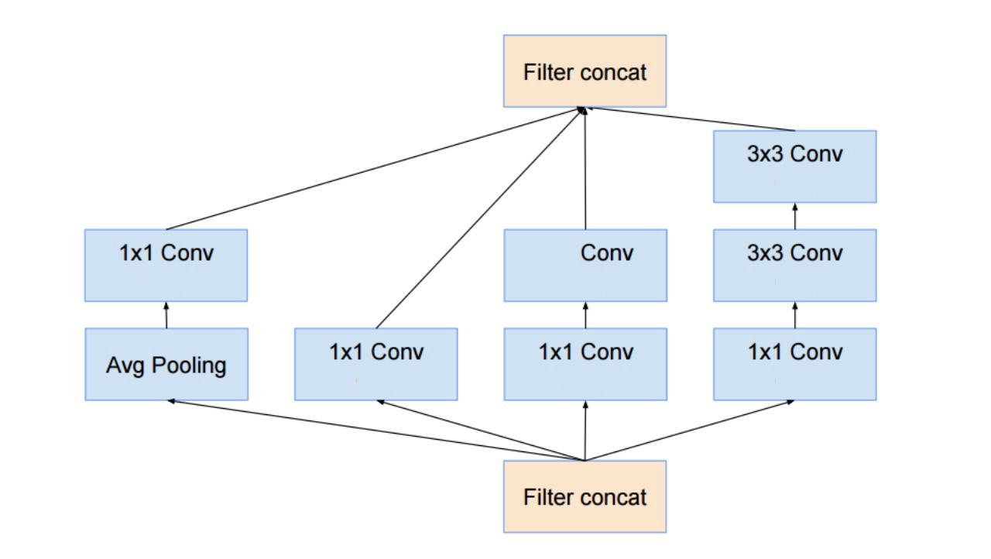
Inception Module
(24)
5x5
(24)
(24)
(24)
(16)
(16)
(16)
https://hacktilldawn.com/2016/09/25/inception-modules-explained-and-implemented/

Slide 22
(24)
5x5
(24)
(24)
(24)
(16)
(16)
(16)

Slide 23
(24)
5x5
(24)
(24)
(24)
(16)
(16)
self.branch1x1 = nn.Conv2d(in_channels, 16, kernel_size=1)
branch1x1 = self.branch1x1(x)
(16)

Slide 24
(24)
5x5
(24)
(24)
(24)
(16)
(16)
self.branch1x1 = nn.Conv2d(in_channels, 16, kernel_size=1)
branch1x1 = self.branch1x1(x)
(16)
outputs =
[branch1x1,
branch5x5,
branch3x3dbl,
branch_pool]
self.branch_pool = nn.Conv2d(in_channels, 24, kernel_size=1)
branch_pool = F.avg_pool2d(x, kernel_size=3, stride=1, padding=1)
branch_pool = self.branch_pool(branch_pool)

Slide 25
self.branch3x3dbl_1 = nn.Conv2d(in_channels, 16, kernel_size=1)
self.branch3x3dbl_2 = nn.Conv2d(16, 24, kernel_size=3, padding=1)
self.branch3x3dbl_3 = nn.Conv2d(24, 24, kernel_size=3, padding=1)
branch3x3dbl = self.branch3x3dbl_1(x)
branch3x3dbl = self.branch3x3dbl_2(branch3x3dbl)
branch3x3dbl = self.branch3x3dbl_3(branch3x3dbl)
(24)
5x5
(24)
(24)
(24)
(16)
(16)
self.branch1x1 = nn.Conv2d(in_channels, 16, kernel_size=1)
branch1x1 = self.branch1x1(x)
(16)
self.branch_pool = nn.Conv2d(in_channels, 24, kernel_size=1)
branch_pool = F.avg_pool2d(x, kernel_size=3, stride=1, padding=1)
branch_pool = self.branch_pool(branch_pool)

Slide 26
self.branch3x3dbl_1 = nn.Conv2d(in_channels, 16, kernel_size=1)
self.branch3x3dbl_2 = nn.Conv2d(16, 24, kernel_size=3, padding=1)
self.branch3x3dbl_3 = nn.Conv2d(24, 24, kernel_size=3, padding=1)
branch3x3dbl = self.branch3x3dbl_1(x)
branch3x3dbl = self.branch3x3dbl_2(branch3x3dbl)
branch3x3dbl = self.branch3x3dbl_3(branch3x3dbl)
self.branch5x5_1 = nn.Conv2d(in_channels, 16, kernel_size=1)
self.branch5x5_2 = nn.Conv2d(16, 24, kernel_size=5, padding=2)
branch5x5 = self.branch5x5_1(x)
branch5x5 = self.branch5x5_2(branch5x5)
(24)
5x5
(24)
(24)
(24)
(16)
(16)
self.branch1x1 = nn.Conv2d(in_channels, 16, kernel_size=1)
branch1x1 = self.branch1x1(x)
(16)
self.branch_pool = nn.Conv2d(in_channels, 24, kernel_size=1)
branch_pool = F.avg_pool2d(x, kernel_size=3, stride=1, padding=1)
branch_pool = self.branch_pool(branch_pool)

Slide 27
self.branch3x3dbl_1 = nn.Conv2d(in_channels, 16, kernel_size=1)
self.branch3x3dbl_2 = nn.Conv2d(16, 24, kernel_size=3, padding=1)
self.branch3x3dbl_3 = nn.Conv2d(24, 24, kernel_size=3, padding=1)
branch3x3dbl = self.branch3x3dbl_1(x)
branch3x3dbl = self.branch3x3dbl_2(branch3x3dbl)
branch3x3dbl = self.branch3x3dbl_3(branch3x3dbl)
self.branch5x5_1 = nn.Conv2d(in_channels, 16, kernel_size=1)
self.branch5x5_2 = nn.Conv2d(16, 24, kernel_size=5, padding=2)
branch5x5 = self.branch5x5_1(x)
branch5x5 = self.branch5x5_2(branch5x5)
(24)
5x5
(24)
(24)
(24)
(16)
(16)
self.branch1x1 = nn.Conv2d(in_channels, 16, kernel_size=1)
branch1x1 = self.branch1x1(x)
(16)
outputs =
[branch1x1,
branch5x5,
branch3x3dbl,
branch_pool]
self.branch_pool = nn.Conv2d(in_channels, 24, kernel_size=1)
branch_pool = F.avg_pool2d(x, kernel_size=3, stride=1, padding=1)
branch_pool = self.branch_pool(branch_pool)

Slide 28
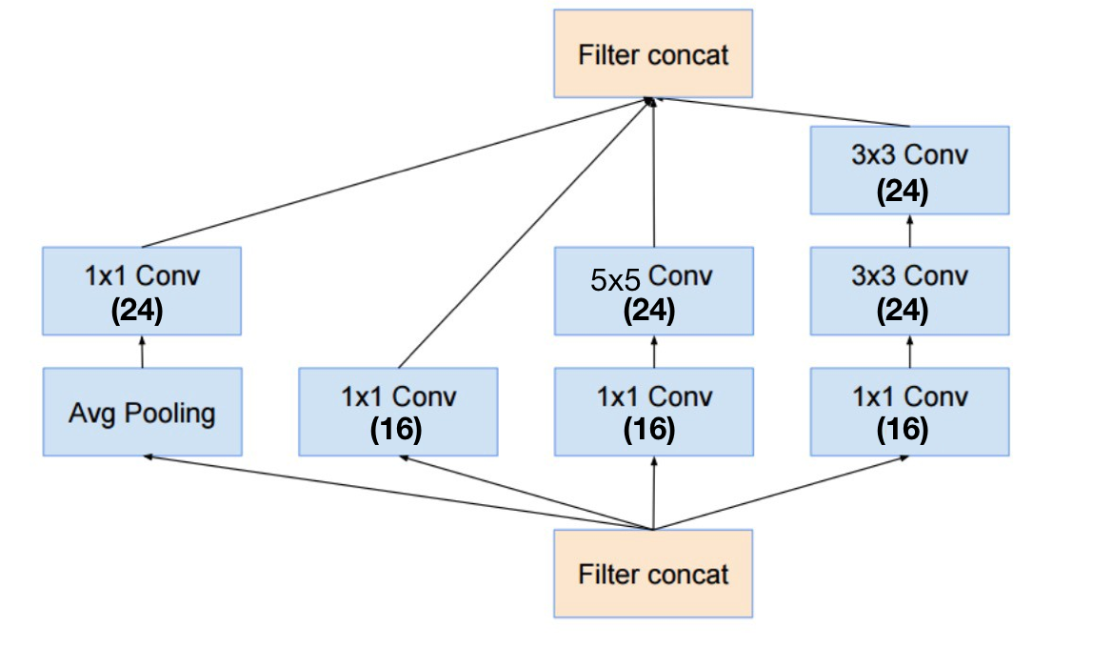
Inception Module
class InceptionA(nn.Module):
def __init__(self, in_channels):
super(InceptionA, self).__init__()
self.branch1x1 = nn.Conv2d(in_channels, 16, kernel_size=1)
self.branch5x5_1 = nn.Conv2d(in_channels, 16, kernel_size=1)
self.branch5x5_2 = nn.Conv2d(16, 24, kernel_size=5, padding=2)
self.branch3x3dbl_1 = nn.Conv2d(in_channels, 16, kernel_size=1)
self.branch3x3dbl_2 = nn.Conv2d(16, 24, kernel_size=3, padding=1)
self.branch3x3dbl_3 = nn.Conv2d(24, 24, kernel_size=3, padding=1)
self.branch_pool = nn.Conv2d(in_channels, 24, kernel_size=1)
def forward(self, x):
branch1x1 = self.branch1x1(x)
branch5x5 = self.branch5x5_1(x)
branch5x5 = self.branch5x5_2(branch5x5)
branch3x3dbl = self.branch3x3dbl_1(x)
branch3x3dbl = self.branch3x3dbl_2(branch3x3dbl)
branch3x3dbl = self.branch3x3dbl_3(branch3x3dbl)
branch_pool = F.avg_pool2d(x, kernel_size=3, stride=1, padding=1)
branch_pool = self.branch_pool(branch_pool)
outputs = [branch1x1, branch5x5, branch3x3dbl, branch_pool]
return torch.cat(outputs, 1)
class Net(nn.Module):
def __init__(self):
super(Net, self).__init__()
self.conv1 = nn.Conv2d(1, 10, kernel_size=5)
self.conv2 = nn.Conv2d(88, 20, kernel_size=5)
self.incept1 = InceptionA(in_channels=10)
self.incept2 = InceptionA(in_channels=20)
self.mp = nn.MaxPool2d(2)
self.fc = nn.Linear(1408, 10)
def forward(self, x):
in_size = x.size(0)
x = F.relu(self.mp(self.conv1(x)))
x = self.incept1(x)
x = F.relu(self.mp(self.conv2(x)))
x = self.incept2(x)
x = x.view(in_size, -1) # flatten the tensor
x = self.fc(x)
return F.log_softmax(x)
https://github.com/.../torchvision/models/inception.py
Notes:
\hat{y}=x*w+b
loss = \frac{1}{N}\sum_{n=1}^{N} y^{(n)} \log \hat{y}^{(n)} + (1 - y^{(n)}) \log (1-\hat{y}^{(n})

Slide 29
Inception Module
Train Epoch: 9 [44800/60000 (75%)] Loss: 0.064180
Train Epoch: 9 [45440/60000 (76%)] Loss: 0.020339
Train Epoch: 9 [46080/60000 (77%)] Loss: 0.061476
Train Epoch: 9 [46720/60000 (78%)] Loss: 0.039662
Train Epoch: 9 [47360/60000 (79%)] Loss: 0.026798
Train Epoch: 9 [48000/60000 (80%)] Loss: 0.071569
Train Epoch: 9 [48640/60000 (81%)] Loss: 0.003835
Train Epoch: 9 [49280/60000 (82%)] Loss: 0.005564
Train Epoch: 9 [49920/60000 (83%)] Loss: 0.020116
Train Epoch: 9 [50560/60000 (84%)] Loss: 0.128114
Train Epoch: 9 [51200/60000 (85%)] Loss: 0.016599
Train Epoch: 9 [51840/60000 (86%)] Loss: 0.006995
Train Epoch: 9 [52480/60000 (87%)] Loss: 0.111267
Train Epoch: 9 [53120/60000 (88%)] Loss: 0.052126
Train Epoch: 9 [53760/60000 (90%)] Loss: 0.034962
Train Epoch: 9 [54400/60000 (91%)] Loss: 0.029465
Train Epoch: 9 [55040/60000 (92%)] Loss: 0.031482
Train Epoch: 9 [55680/60000 (93%)] Loss: 0.015132
Train Epoch: 9 [56320/60000 (94%)] Loss: 0.010435
Train Epoch: 9 [56960/60000 (95%)] Loss: 0.014344
Train Epoch: 9 [57600/60000 (96%)] Loss: 0.014952
Train Epoch: 9 [58240/60000 (97%)] Loss: 0.153132
Train Epoch: 9 [58880/60000 (98%)] Loss: 0.112024
Train Epoch: 9 [59520/60000 (99%)] Loss: 0.009406
Test set: Average loss: 0.0470, Accuracy: 9866/10000 (99%)
class Net(nn.Module):
def __init__(self):
super(Net, self).__init__()
self.conv1 = nn.Conv2d(1, 10, kernel_size=5)
self.conv2 = nn.Conv2d(88, 20, kernel_size=5)
self.incept1 = InceptionA(in_channels=10)
self.incept2 = InceptionA(in_channels=20)
self.mp = nn.MaxPool2d(2)
self.fc = nn.Linear(1408, 10)
def forward(self, x):
in_size = x.size(0)
x = F.relu(self.mp(self.conv1(x)))
x = self.incept1(x)
x = F.relu(self.mp(self.conv2(x)))
x = self.incept2(x)
x = x.view(in_size, -1) # flatten the tensor
x = self.fc(x)
return F.log_softmax(x)
Notes:
\hat{y}=x*w+b
loss = \frac{1}{N}\sum_{n=1}^{N} y^{(n)} \log \hat{y}^{(n)} + (1 - y^{(n)}) \log (1-\hat{y}^{(n})

Slide 30
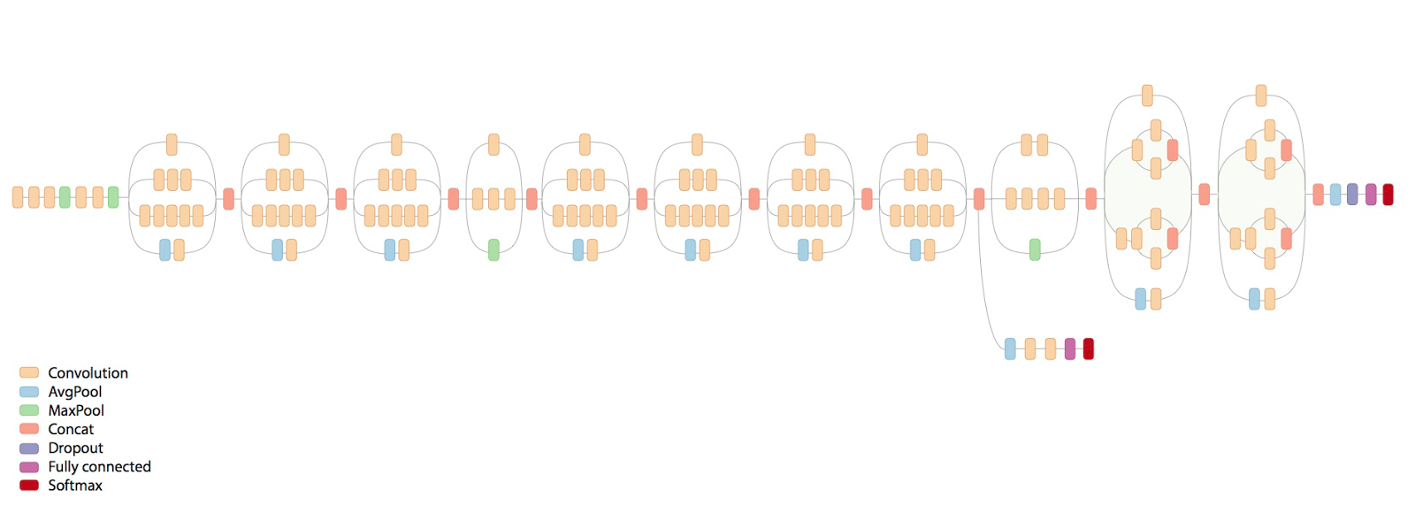
Exercise 2: Implement full inception v3/v4
https://research.googleblog.com/2016/08/improving-inception-and-image.html

Slide 31
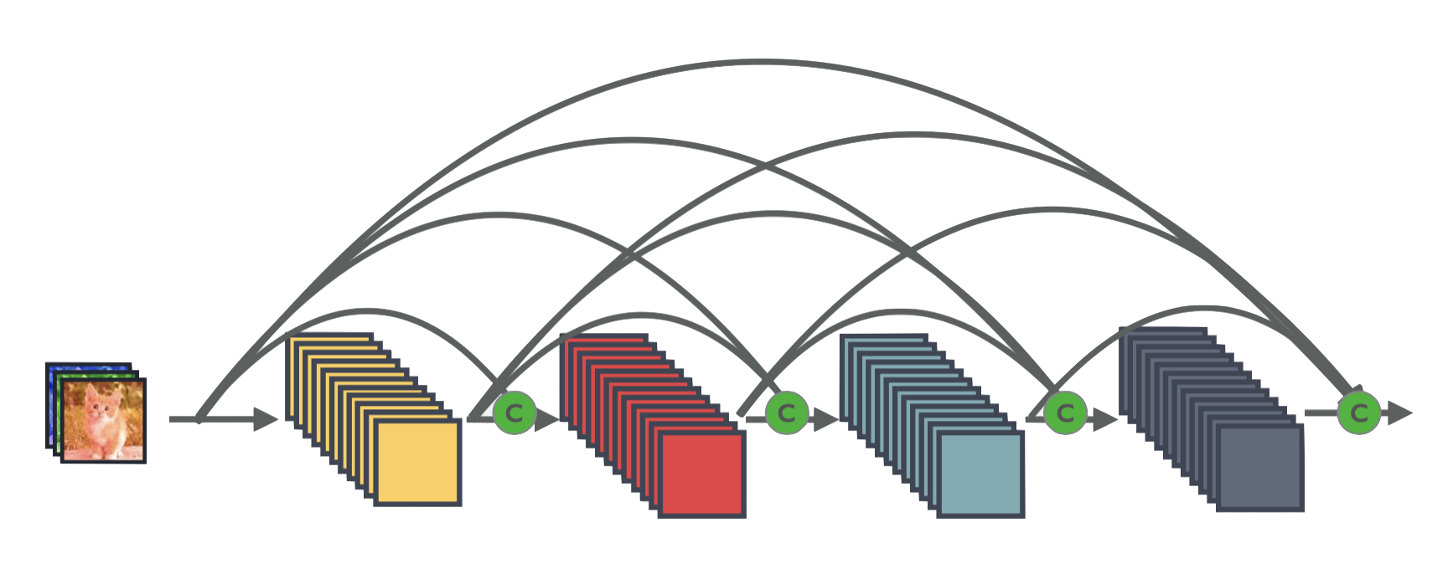
Exercise 3: Implement DensetNet
https://arxiv.org/abs/1608.06993

Slide 32


Lecture 11:
RNN

